Slide 1
Getting started with FHIR
Ewout Kramer
FHIR Developer Days
November 24th, 2014

Slide 2
Contents of this tutorial
Deconstructing FHIR
FHIR RESTful service interface
Beyond REST
Profiles and Validation

Slide 3
Deconstructing FHIR
Looking at FHIR data modeling concepts from a software engineering perspective
Notes:
Time: 10:00-40:00 (30 minutes)

Slide 4


Resources (review!)
“Resources” are:
Small logically discrete units of exchange
Defined behaviour and meaning
Known identity / location
Smallest unit of transaction
“of interest” to healthcare
V2: Sort of like Segments
V3: Sort of like CMETs

Slide 5

Structure of a Resource
Metadata
Resource
Narrative
Elements
Extensions
Extensions

Slide 6
Composition versus reference
FHIR makes composition and references explicit:
References are in between Resources. No context conduction across references – safe retrieval as individual resources.
Composition is within a Resource: Components have no meaning outside resource, no identity, no separate access path except through resource
Notes:
No context conduction: if a Condition resource references a particular Patient as it's subject, and it links to a Procedure resource as it's cause, there is no automatic rule or implication that the procedure has the same patient as it's subject.

Slide 7
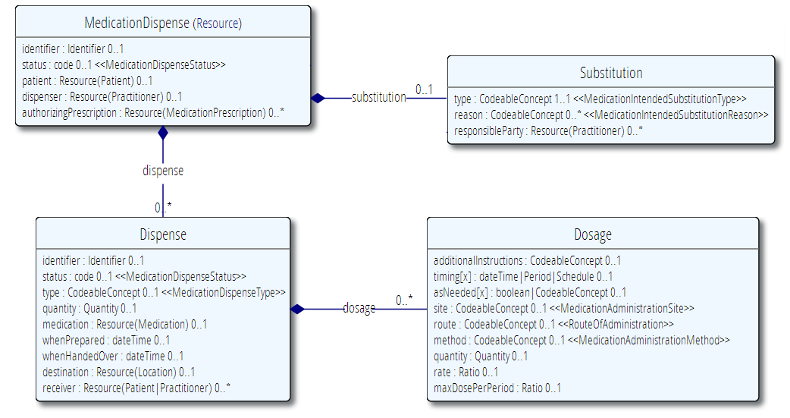
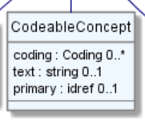
Composition of a Resource
Resource Root
Resource Component
Simple & Complex elements (may be repeating)
Notes:
Medication Dispense – the Resource root
Dispense & Substitution are components within Medication Dispense
Use of non-primitive “datatypes” / “value types”

Slide 8
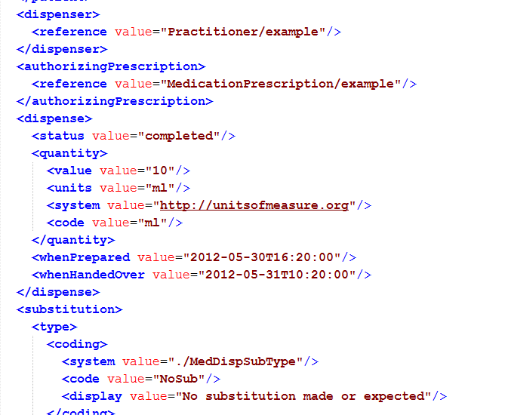
Composition

Slide 9
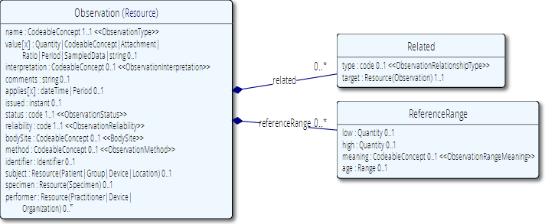
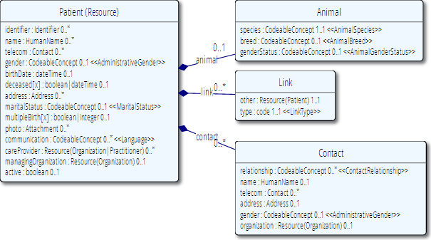
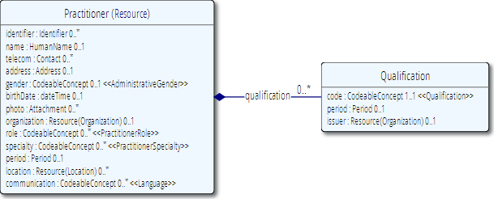
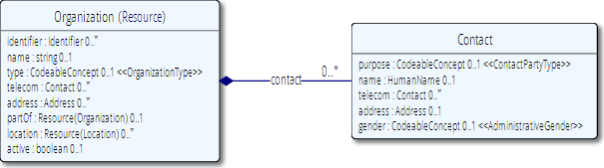
Network
subject
performer
organization

Slide 10
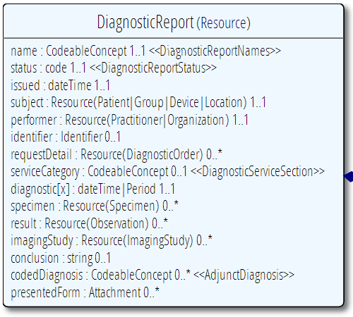
Diagnostic
Report
Patient
Practitioner
Observation
Notes:
References between resources are not by “business key”, it is *not* the patient id, it’s a REST URI!

Slide 11
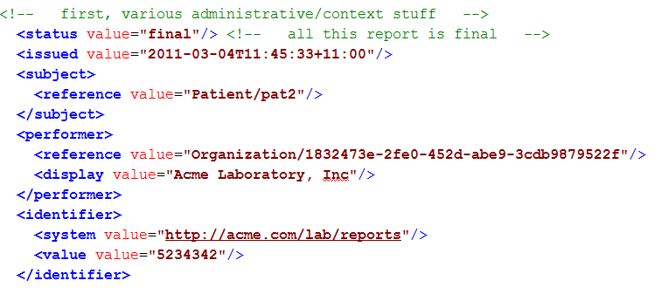
Resource Reference
Example: part of DiagnosticReport

Slide 12
Rules for references
References can be relative or absolute
References don’t have to be to the same server
Server does not have to enforce integrity
Clients need to cater for broken links
Targets can be ‘contained’ in the resource:
<Procedure xmlns="http://hl7.org/fhir">
<contained>
<Patient id="pat">
</Patient>
</contained>
<subject>
<reference value="#pat"/>
</subject>

Slide 13
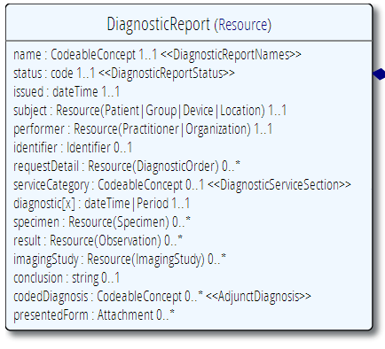
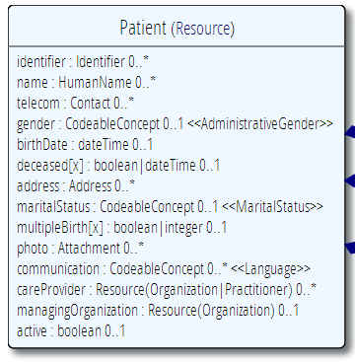
“Business” identifiers
Notes:
Resource Id’s (=URLs) are infrastructural id’s, they differ from “business” identifier.
Many Resources also have business identifiers, they are explicitly modeled, like Patient.identifier (even more than one identifier possible!)
Business identifiers are completely separate from technical resource id’s

Slide 14
A Resource’s identity
In fact: an URL
http://server.org/fhir/Patient/1
resource type
endpoint
identifier
Note: This URL resolves to the current version of a resource
Notes:
This is not only the URL you use to retrieve the resource, it’s also its id.
All URL’s in FHIR are case-sensitive (and so is the id)
It is *metadata*, you won’t find this in the Resource’s definition

Slide 15
Resource metadata
Metadata
Patient
MRN 22234
“Ewout Kramer”
30-11-1972
Amsterdam
Resource Identities
http://fhir.hl7.org/Patient/23E455A3B
http://fhir.hl7.org/Patient/23E455A3B/_history/4
Last updated
2013-12-23T23:33:01+01:00
http://hl7.org/fhir/tag http://example.org/fhir/Status#Test
http://hl7.org/fhir/tag/profile http://hl7.org/fhir/Profile/us-core

Slide 16
The FHIR Elements
Composite
Datatypes (HumanName, Quantity, Period, Address, Identifier )
Constrained Types (Quantity: Distance, Count, Duration, Money)
Metadata
Resource
Narrative
use
Elements
use
Extensions
Extensions
Primitives (integer, boolean,
string, instant)
use
Derived Primitives
(oid, uuid, code, id)
Notes:
Only the Resources are user-definable, other types are “built-in”
Derived primitives are patterns -> validation consists of regexp matching
Constrained types are defined using invariants (OCL, Xpath, prose) -> validation using schematron, code
Narrative and Extension are both ONLY used in Resources
Resources can use both (derived) primitives and composite datatypes in its definitions
Infrastructural types need special handling, not general-purpose types

Slide 17
Start at the bottom: Primitives
boolean | xs:boolean | Values can be either true or false
integer | xs:int | A signed 32-bit integer
decimal | xs:decimal | A rational number. A true decimal, with inbuilt precision (e.g. Java BigDecimal)
base64Binary | xs:base64Binary | A stream of bytes, base64 encoded
instant | xs:dateTime | An instant in time - known at least to the second and always includes a timezone.
string | xs:string | A sequence of Unicode characters.
uri | xs:anyURI | A Uniform Resource Identifier Reference.
date | union of xs:date, xs:gYearMonth, xs:gYear | A date, or partial date as used in human communication. No time zone.
dateTime | union of xs:dateTime, xs:date, xs:gYearMonth, xs:gYear | A date, date-time or partial date as used in human communication. If hours and minutes are specified, a time zone must be populated.
Notes:
The lexical rendering for these primitives in Xml is the same as in JSON (maybe this should go in the serialization section)
Expressing the allowed values in terms of XSD primitives brings in more variability then we would like. E.g. “0” and “1” are valid for xs:boolean. “+000004”, “4”, “+4” are all valid decimals.

Slide 18
Derived primitives
Using the ISO date/time with timezone
“1951”, “1951-06” and “1951-06-04”
“1951-06-04T10:57:34.0321+01”
“1951-06-04T10:57:34.0321Z”
Notes:
TODO: Search on timestamps (lower, upper bound), converting to zulu, user-timezone, sorting of times etc.
* Old-school types built on classis logic and math from the Greek, we have new stuff too…types based on urls!

Slide 19
Derived primitives
Based on uri(!): OID and UUID
urn:oid:1.2.3.4.5
urn:uuid:a5afddf4-e880-459b-876e-e4591b0acc11
Based on string:
code (string of characters, may contain single spaces) - “4548-4”, “active”, “not known”
id ([a-z0-9\-\.]{1,36})
Notes:
TODO: Search on timestamps (lower, upper bound), converting to zulu, user-timezone, sorting of times etc.
* Old-school types built on classis logic and math from the Greek, we have new stuff too…types based on urls!

Slide 20
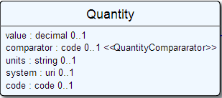
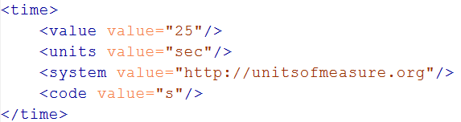
Level up: Composite Datatypes
Notes:
The content of a primitive is not rendered in XML as a text node but as an attribute
Notice how the “system” of a code is now a uri, so unlike in v3 an OID is now ALSO a uri (urn:oid:1.2.3.4.5)

Slide 21
Datatypes
Let’s take a look at the “Data Types” section of the FHIR specification at
http://www.hl7.org/implement/standards/fhir/datatypes.html
Notes:
Datatypes use both primitives and other datatypes.
Some datatypes use attributes with cardinality > 1
CodeableConcept.primary is actually refers to a coding in CodeableConcept.coding, so is not a code itself.
Quantity has constrained variations Distance, Count, Duration, Money. They introduce constraints on useable units, but do not add attributes, so not shown here.
Note that HumanId.assigner refers to a Resource

Slide 22
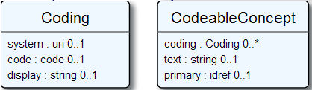

Coded types
Codes are defined in code systems
Notes:
Examples is from http://www.hl7.org/implement/standards/fhir/observation.htm
Bindings can be Incomplete (HL7 defines some codes for it, but you can add your own), Fixed (HL7 defines the only codes that are allowed) and Example (no specific codes defined, but some are given to give you an idea of what goes in the element)

Slide 23
Want to know more?
Terminology, ValueSets, Codesystems
By Lloyd
Tuesday Q4 (15:30-17:00)

Slide 24
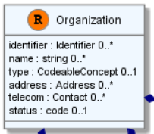
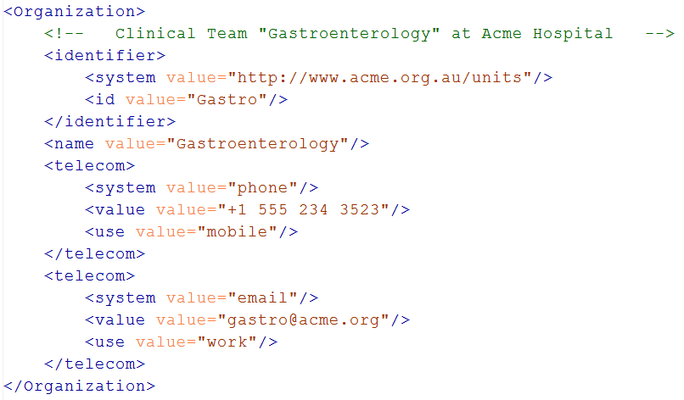
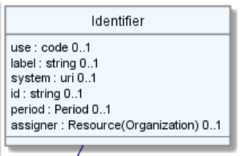
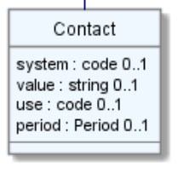
Level up: resources
Notes:
The element “identifier” is of type Identifier
The element “telecom” repeats, there is no notion of a “list” in Xml.
Empty elements are left out

Slide 25
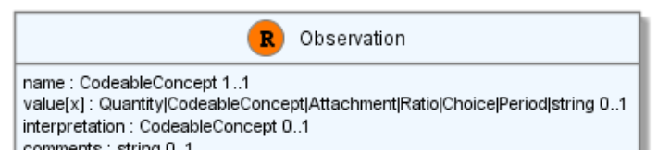
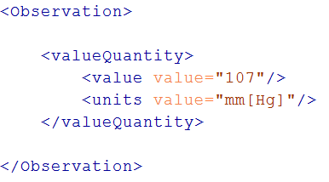
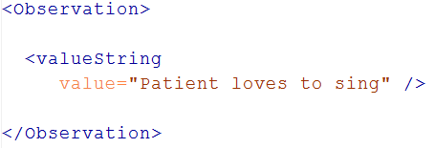
“Choice” properties
Notes:
* value[x] means: An element with a name that starts with “value”. The [x] is replaced by the (capitalized) name of the actual datatype

Slide 26
Quick look at extensions
Metadata
Resource
Narrative
Elements
Extensions
Extensions
Notes:
Only the Resources are user-definable, other types are “built-in”
Derived primitives are patterns -> validation consists of regexp matching
Constrained types are defined using invariants (OCL, Xpath, prose) -> validation using schematron, code
Narrative and Extension are both ONLY used in Resources
Resources can use both (derived) primitives and composite datatypes in its definitions
Infrastructural types need special handling, not general-purpose types

Slide 27
Extensions
FHIR has a standard framework for extensions
Built into wire format
Every FHIR element can be extended
Including datatypes
Every extension has:
Reference to a computable definition
Value – from a set of known types
Every system can read, write, store and exchange all legal extensions
All extensions are valid by schema etc.

Slide 28
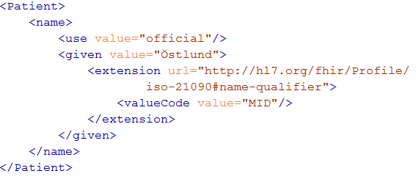
Extending a name
Key = location of formal definition
Value = value according to definition

Slide 29
Extensions
In FHIR, extensions are “normal”
Consequence of the 80% rule – keep the simple stuff simple
Extensions can exist anywhere
Yes, even inside boolean or date
Conformant systems can’t reject instances just because they contain unrecognized extensions
They could:
Display them
Should be in resource narrative
Store as a ‘Blob’
Make a conscious decision to ignore (unless ModifierExtension)
(Could lookup profile)
Notes:
[31/08/14 3:34:55 pm] Lloyd McKenzie: no. They can't refuse the instance because it contains extensions (unless they're modifierExtensions), but they're free to strip/ignore them.
[31/08/14 3:35:19 pm] Lloyd McKenzie: Requiring persistance would cause havoc with legacy systems

Slide 30
Modifier Extensions
Also a core part of FHIR
Needed because some extensions can’t be safely ignored
Can’t compute on an element containing an unrecognized modifier extension. However, can:
Reject instance
Just display narrative
Retrieve definition & seek human review

Slide 31
Governing Extensions
Extensions are not a silver bullet
FHIR has a sliding scale governance for extensions
HL7 published extensions
National Standards (e.g. Standard Finnish Extensions)
Domain standards (e.g. Best Practice Cardiology)
Local Projects

Slide 32
Quick look at narrative
Metadata
Resource
Narrative
Elements
Extensions
Extensions
Notes:
Only the Resources are user-definable, other types are “built-in”
Derived primitives are patterns -> validation consists of regexp matching
Constrained types are defined using invariants (OCL, Xpath, prose) -> validation using schematron, code
Narrative and Extension are both ONLY used in Resources
Resources can use both (derived) primitives and composite datatypes in its definitions
Infrastructural types need special handling, not general-purpose types

Slide 33
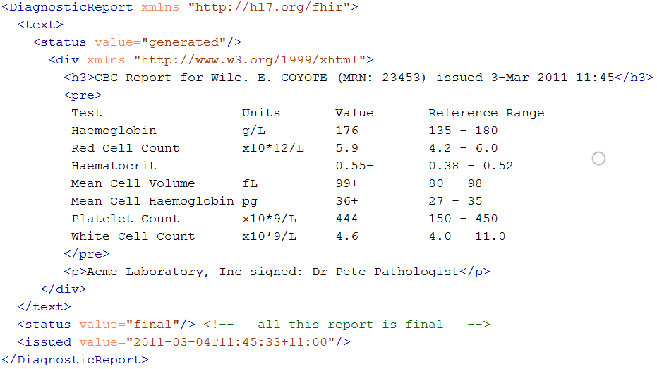
Narrative
Notes:
Resources SHOULD always contain narrative to support human-consumption as a fallback. However, in a strictly managed trading systems where all systems share a common data model and additional text is unnecessary or even a clinical safety risk, the narrative may be omitted.

Slide 34
REST service interface
How FHIR uses RESTful principles to communicate Resources
Notes:
Time: 0:50:00-1:30:00 (40 minutes)

Slide 35
Paradigms
FHIR supports 4 interoperability paradigms
REST
Documents
Messages
Services
REST
Notes:
* Content is the same

Slide 36
REST?
“REpresentational State Transfer”
Represent your data as “resources”
Make “Resources” URI addressable
Use HTTP to do CRUD operations
Resources may be exchanged using different representations

Slide 37
Possibly distributed…
FHIR server @ pat.registry.org
FHIR server @ lab.hospitalA.org
Patient/223
DiagnosticReport/4445
Observation/3ff27
Patient
subject
Observation
Diagnostic
Report
result
managing
performer
FHIR server @ hospitalA.org
Organization/1
Practitioner/87
Organization
Practitioner

Slide 38
Just a quick GET
GET /fhir/Patient/1 HTTP/1.1
HTTP/1.1 200 OK
Content-Type: application/xml+fhir;charset=utf-8
Content-Length: 787
Content-Location:
http://fhir.furore.com/fhir/Patient/1/_history/1
Last-Modified: Tue, 29 May 2012 23:45:32 GMT
HTTP Verb + path
UTF-8 encoded
<?xml version="1.0" encoding="UTF-8"?>
<Patient xmlns="http://hl7.org/fhir"><identifier><label>SSN</label><identifier><system>
http://hl7.org/fhir/sid/usssn</system><id>444222222</id></identifier></identifier><name><use>official</use><family>Everywoman</family><given>Eve</given></name><telecom><system>phone</system><value>555-555 2003</value><use>work</use></telecom><gender><system>http://hl7.org/fhir/sid/v2-0001</system>
<code>F</code></gender><birthDate>1973-05-31</birthDate><address><use>home</use><line>2222 Home Street</line></address><text><status>generated</status><div xmlns="http://www.w3.org/1999/xhtml">Everywoman, Eve. SSN:444222222</div></text></Patient>
See the BOM?
Notes:
You can retrieve any person using a GET on the person’s id, which is just an url on the server: /fhir/Patient/<id>
We have our own MIME-type: “text/xml+fhir”
Note that FHIR always uses UTF-8. Since this is not the default for HTTP, the server explicitly mentions this
But should mean the xml encoding mentions “utf-8” and that the payload is really encoded in utf-8
There can be a Byte Order Mark, but hopefully your framework handles all that ;-)
The response returns a Content-Location header with a version-specific location….see next slide

Slide 39
A Resource’s REST identity
In fact: an URL
http://server.org/fhir/Patient/1
resource type
endpoint
identifier
Note: This URL resolves to the current version of a resource
Notes:
This is not only the URL you use to retrieve the resource, it’s also its id.
All URL’s in FHIR are case-sensitive (and so is the id)

Slide 40
Remember metadata?
Metadata
Patient
MRN 22234
“Ewout Kramer”
30-11-1972
Amsterdam
Resource Identities
http://fhir.hl7.org/Patient/23E455A3B
http://fhir.hl7.org/Patient/23E455A3B/_history/4
Last updated
2013-12-23T23:33:01+01:00
http://hl7.org/fhir/tag http://example.org/fhir/Status#Test
http://hl7.org/fhir/tag/profile http://hl7.org/fhir/Profile/us-core

Slide 41
Tag metadata
GET /fhir/Patient/1 HTTP/1.1
HTTP/1.1 200 OK
Content-Location: http://sever.om/fhir/Patient/1/_history/12
Last-Modified: Tue, 29 May 2012 23:45:32 GMT
Category: http://example.org/fhir/Status#Test; scheme=" http://hl7.org/fhir/tag"; label="Our test tag"
http://hl7.org/fhir/tag | A general tag
http://hl7.org/fhir/tag/profile | A profile tag - a claim that the Resource conforms to the profile identified in the term
http://hl7.org/fhir/tag/security | A security label
Notes:
Just a quick look at tags, so the term had been mentioned

Slide 42
Mapping (meta)data to HTTP
Resource data
Resource id
Resource version
Last update date
Tags
http body
Url
Content-Location header
Last-Modified header
Category header

Slide 43
One more look at the header
GET /fhir/Patient/1 HTTP/1.1
HTTP/1.1 200 OK
Content-Type: application/xml+fhir;charset=utf-8
Content-Length: 787
Content-Location: http://fhir.furore.com/fhir/Patient/1/_history/12
Last-Modified: Tue, 29 May 2012 23:45:32 GMT
Notes:
You can retrieve any person using a GET on the person’s id, which is just an url on the server: /fhir/person/@<id>
We have our own MIME-type: “text/xml+fhir”
Note that FHIR always uses UTF-8. Since this is not the default for HTTP, the server explicitly mentions this
But should mean the xml encoding mentions “utf-8” and that the payload is really encoded in utf-8
There can be a Byte Order Mark, but hopefully your framework handles all that ;-)
The response returns a Content-Location header with a version-specific location….see next slide

Slide 44
For a specific version…
We have the version-specific URL
http://server.org/fhir/ (continued)
Patient/1/_history/4
base path
resource type
identifier
version id
Notes:
Both the Resource id URL and the version-specific URL are used on many places of the REST spec and resource content (References!). They are always used consistently in this form.

Slide 45
Support for versions
33, v12 – 2012-12-04
/server.org/fhir/Patient/33/_history/12
33, v13 – 2012-12-05
/server.org/fhir/Patient/33/_history/13
33, v14 – 2012-12-08
/server.org/fhir/Patient/33/_history/14
33, v15 – 2012-12-09
/server.org/fhir/Patient/33/_history/15
/server.org/fhir/Patient/33
Notes:
* Note that you have two ways (at one moment) to reach version 15

Slide 46
REST “representations”
GET /fhir/Patient/1?_format=json HTTP/1.1
HTTP/1.1 200 OK
Content-Type: application/json+fhir;charset=utf-8
Content-Length: 787
GET /fhir/Patient/1 HTTP/1.1
Accept: application/json+fhir
HTTP/1.1 200 OK
Content-Type: application/json+fhir;charset=utf-8
Content-Length: 787
Notes:
You can retrieve any patient using a GET on the patient’s id, which is just an url on the server: /fhir/Patient/<id>
We have our own MIME-type: “application/xml+fhir” and “application/json+fhir”

Slide 47
REST in the spec
Let’s look at these operations in the specification….

Slide 48
Mapping to verbs
create 2.1.10
The create interaction creates a new resource in a server assigned location. The create interaction is performed by an HTTP POST operation as shown:
POST [service-url]/[resourcetype] (?_format=mimeType)
read 2.1.6
The read interaction accesses the current contents of a resource. The interaction is performed by an HTTP GET operation as shown:
GET [service-url]/[resourcetype]/{id} (?_format=mimeType)
update 2.1.8
The update interaction creates a new current version for an existing resource or creates a new resource if no resource already exists for the given id. The update interaction is performed by an HTTP PUT operation as shown:
PUT [service-url]/[resourcetype]/{id} (?_format=mimeType)
delete 2.1.9
The delete interaction removes an existing resource. The interaction is performed by an HTTP DELETE operation as shown:
DELETE [service-url]/[resourcetype]/{id}

Slide 49
To create a resource
You POST the contents to an url which indicates the resource type:
E.g. http://server.org/fhir/Patient
Supply body’s format in Content-Type header
Server returns 201 (Created).
Returns only the newly assigned version id URL in the Location header.

Slide 50
To update a resource
Use PUT on the resource’s URL, with the new contents in the body
Tell server the body’s format (xml/json) in the Content-Type header
Server returns 200 and the URL to new version in the Content-Location header.

Slide 51
Want to know more?
FHIR API for Java programmers
By James
Monday Q3 (13:45-15:15)
FHIR API for .NET programmers
By Mirjam
Monday Q3 (13:45-15:15)

Slide 52
BUNDLES
How FHIR uses Atom to communicate sets of resources
Notes:
Time: 0:50:00-1:30:00 (40 minutes)

Slide 53
Communicating lists
We need to communicate lists of Resources
Search result
History
Documents or messages
Multiple-resource inserts (“batches”)
So, we need an industry-standard to represent lists, and a place to put our metadata

Slide 54

Resource
Bundle
Metadata
Metadata
Bundle
Resource
Resource
Narrative
Elements
Resource
Extensions
Extensions

Slide 55
Bundles
Atom RFC 4287 + Tombstones RFC 6721
Poll-based protocol for keeping up-to-date with newsfeeds (RSS and Atom)
You can “subscribe” to a FHIR feed and get updates
Notes:
- In our previous section on REST we saw how we mapped this metadata to HTTP headers, but in a query result, we need to find a way to map this to a list, Atom

Slide 56
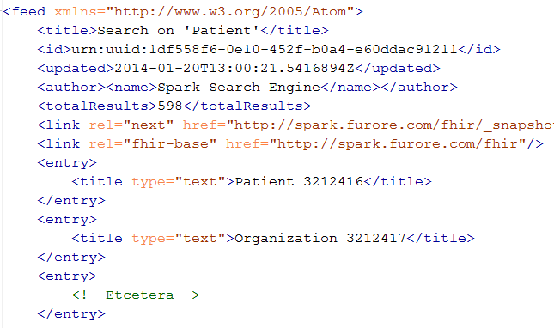
An example Bundle
Notes:
Note that the id of the resource is kept outside the resource itself
Atom has many other meta-data items (not shown), which we will discuss later.

Slide 57
Resource metadata
Metadata
Patient
MRN 22234
“Ewout Kramer”
30-11-1972
Amsterdam
Resource Identity
http://fhir.hl7.org/Patient/23E455A3B
Last updated
2013-12-23T23:33:01+01:00
http://hl7.org/fhir/tag http://example.org/fhir/Status#Test
http://hl7.org/fhir/tag/profile http://hl7.org/fhir/Profile/us-core

Slide 58
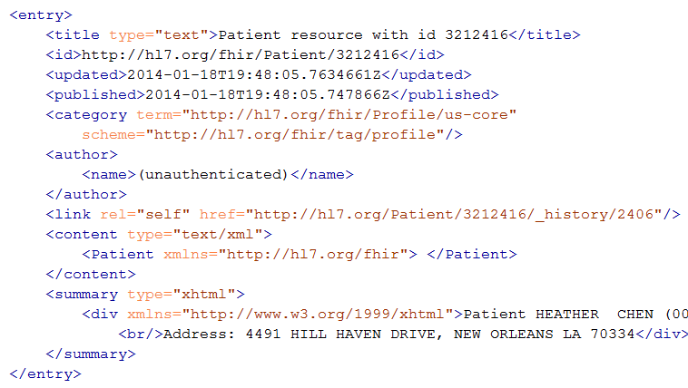
Resource Entry
Resource id
Last modified
Tags
Version-specific id
Resource content
Human-readable form,
just like Resource.text
Notes:
See how the resource meta-data is mapped to equivalent Atom members
Author is required by atom, so you’ll have to keep track who authored the resource, which might well be the user that POSTed it to your RESTful endpoint
Summary is optional, but it is easy to fill it with the Resource’s <text> (human readable narrative), so Feed readers have a way to display the contents of a resource. Yes, this means the summary is present twice in the entry.
All elements you see here are Atom spec, not FHIR

Slide 59
Example: Keeping in sync
History of all resources on server
http://server.org/fhir/_history
History of all patient resources on server
http://server.org/fhir/Patient/_history
History of specific patient on server
http://server.org/fhir/Patient/1/_history
A history of all changes: updates and deletions, ordered by newest first
Limit with _since and _count

Slide 60
SEARCH FUNCTIONALITY
And finally, the last REST operation (for now):
Notes:
Time: 1:30:00-1:50:00 (20 minutes)

Slide 61
Getting “all” patients
http://server.org/fhir/Patient
Always returns a paged feed
Use _count to indicate number of results per page
Special case of the “real” search operation: http://server.org/fhir/Patient/_search?name=eve http://server.org/fhir/Patient?name=eve

Slide 62
Want to know more?
FHIR Search for Client developers
By Mirjam
FHIR Search for Server developers
By Martijn
Monday Q4 (15:30-17:00)

Slide 63
Beyond REST
How FHIR supports messages and documents
Notes:
Time: 1:50:00-2:00:00 (10 minutes)

Slide 64
Paradigms
FHIR supports 4 interoperability paradigms
REST
Documents
Messages
Services

Slide 65

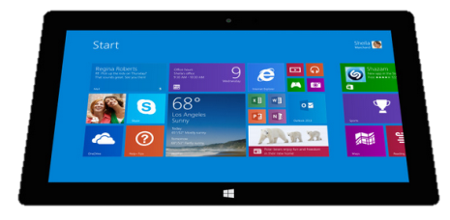
Regardless of paradigm
the content is the same
Receive a lab result in a message…
FHIR
Repository
FHIR Message
FHIR Document
Lab System
REST
National
Exchange
…Package it in a discharge summary document

Slide 66
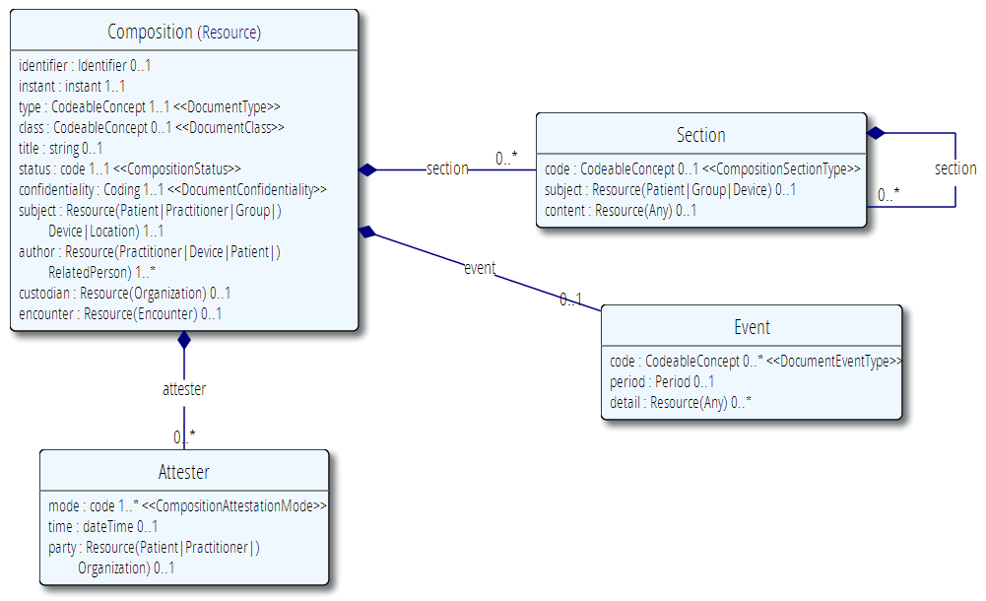
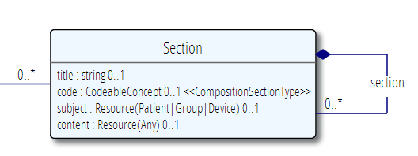
The Document resource
A single Resource, very often a List

Slide 67
FHIR Document
Discharge
Summary Composition
Dr. Bernard Practitioner
Patient Mary Patient
author
subject
Kidney Stones Condition
Chief Complaint section
content
Pulse Observation
Vital Signs list
entry
Physical section
BP Observation
content
Medications section
Discharge Meds list
Dyclofenac MedicationPrescription
content
entry
Tamsulosin MedicationPrescription

Slide 68
Want to know more?
FHIR Documents
By Lloyd
Tuesday Q3 (13:45-15:15)

Slide 69
The Binary Endpoint
http://server.org/fhir/Binary/
Accepts any kind of content
Stores the content as is, along with the content type provided by the HTTP headers.
Acts just like the normal Resource endpoints (but there is no search)

Slide 70
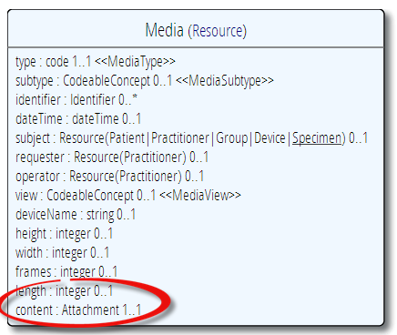
Useful for Attachments
/Binary/23344

Slide 71
Profiles and validation
Short introduction to
Notes:
Time: 40:00-50:00 (10 minutes)

Slide 72
The need for Profiles
Many different contexts in healthcare, but a single set of Resources
Need to be able to describe restrictions based on use and context
Allow for these usage statements to:
Authored in a structured manner
Published in a repository
Used as the basis for validation, code, report and UI generation.

Slide 73
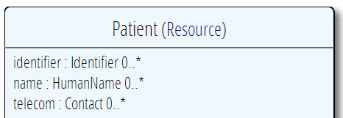
Constraining cardinality
Limit cardinality to 1..2
(e.g. to at maximum your organizations’ identifier + the national one)
1..2
1..1
0..0
Limit names to just 1 (instead of 0..*)
Forbid any telecom elements
Note: something that’s mandatory in the core definition cannot be made optional in a profile

Slide 74
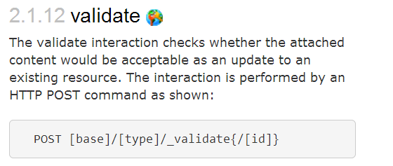
Validation

Slide 75
Want to know more?
Profiles and Validation
By Grahame
Tuesday Q1 (9:00-10:30)
Authoring Profiles
By Michel
Tuesday Q2 (11:00-12:30)

Slide 76

Questions?
http://hl7.org/fhir
http://wiki.hl7.org/index.php?title=FHIR

